Slide 1
Figure 1. (Top) Percentage of authors that are female, stratified by first, middle, senior, or any position. (Bottom) Number of female and male authors over time.

Slide 2
`
Figure 2. Percentage of female and male authors publishing as first or senior authors.

Slide 3
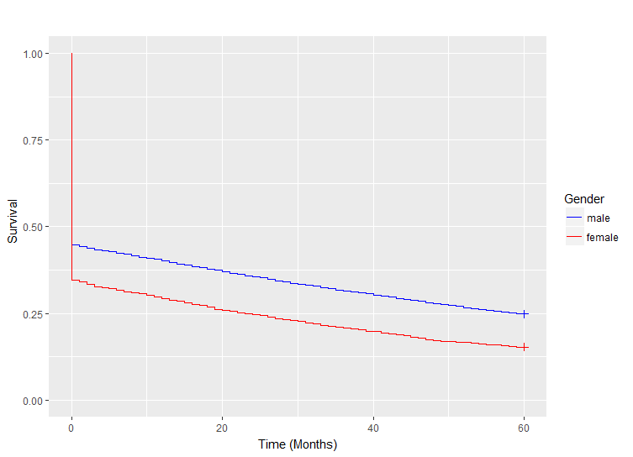
Figure 3. Survival curve of research longevity, indicating elapsed time between first and most recent publication. Greater than 5 years of research longevity is represented at the 5 year time point. Authors who never published again after their first publication are represented as having a research longevity of zero months.

